Slide 1

Александр Юрьевич
Каратаев

Slide 2
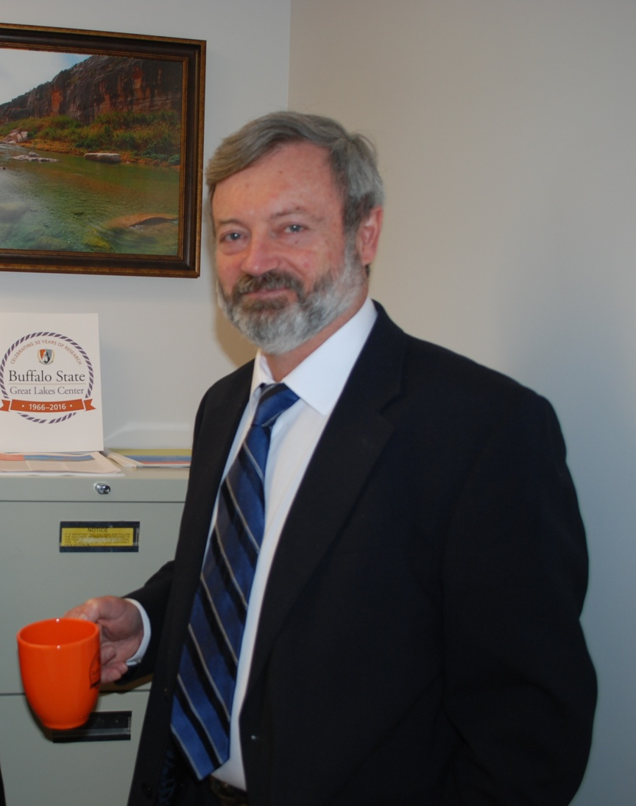
Director of the Great Lakes Center, SUNY Buffalo State

Slide 3
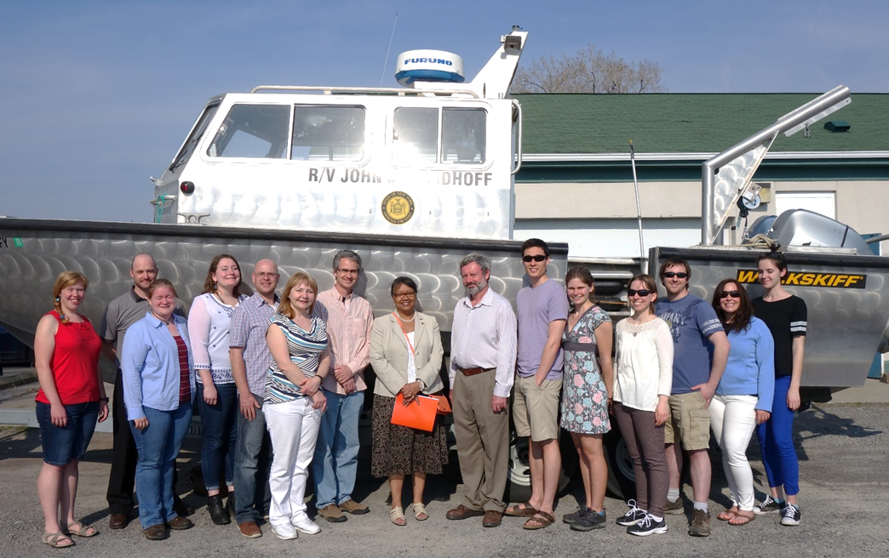
GLC Staff and Collaborators
GLC full time – 16 (including 9 supported by grants)
Student research assistants – 13
Adjunct Professors – 4
Collaborators – 117
GLC staff and research assistants with President Conway-Turner at the Field Station Open House, May 2015

Slide 4
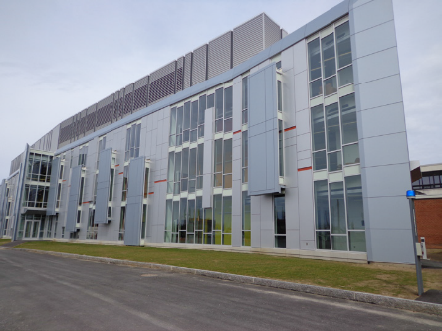
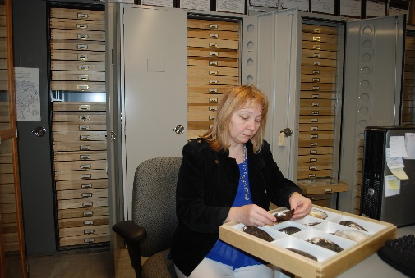
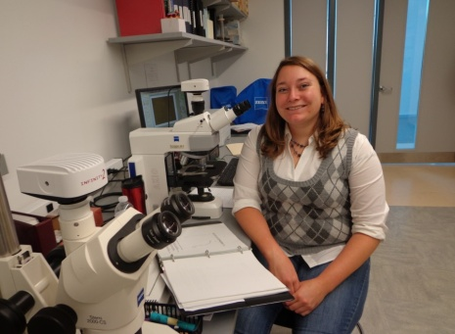
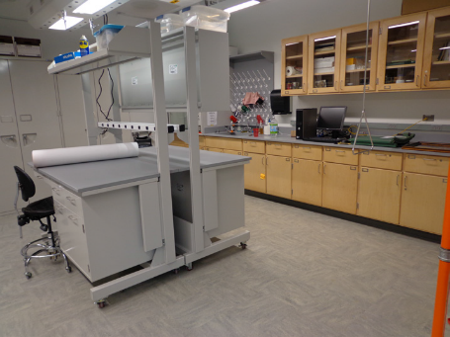
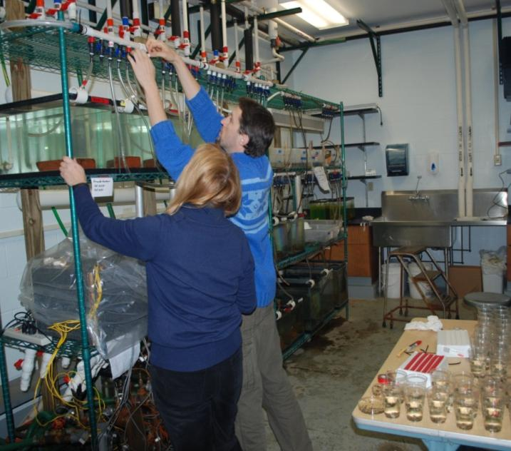
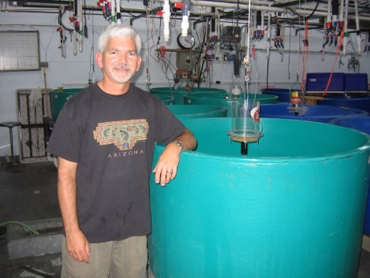
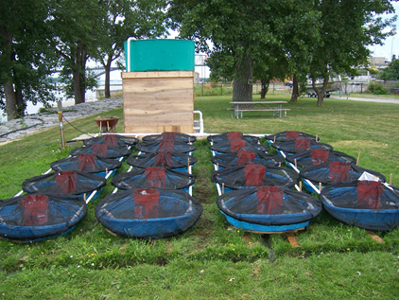
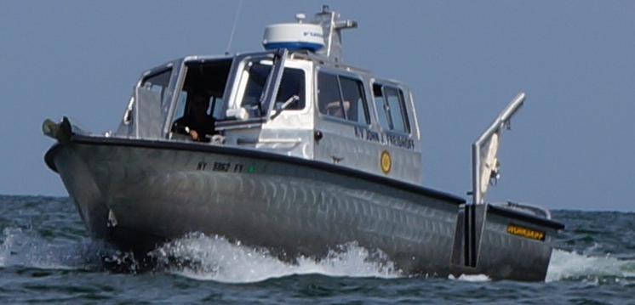
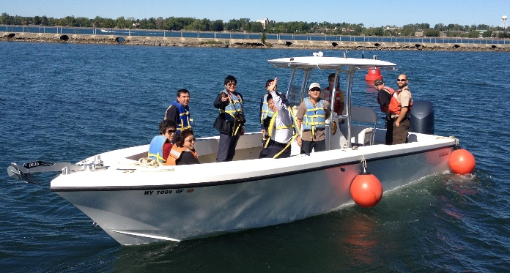
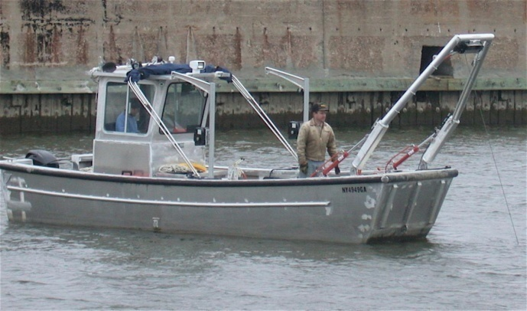
Facilities
Aquatic Ecology laboratories in the new Science and Mathematics Complex
Laboratories at the Field Station on Lake Erie
Fleet of research vessels (15 boats of various types)

Slide 5
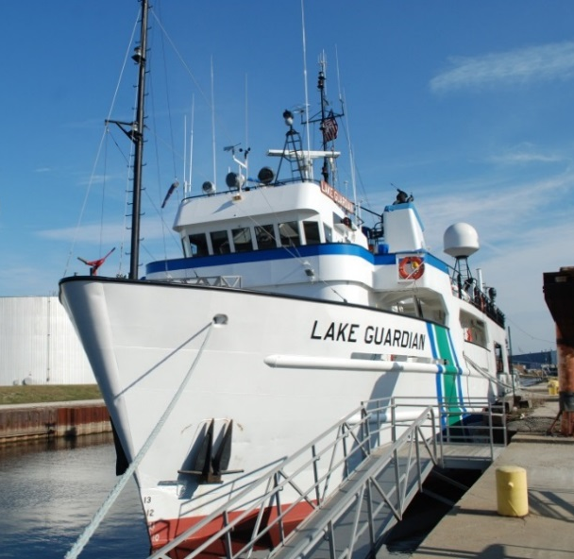
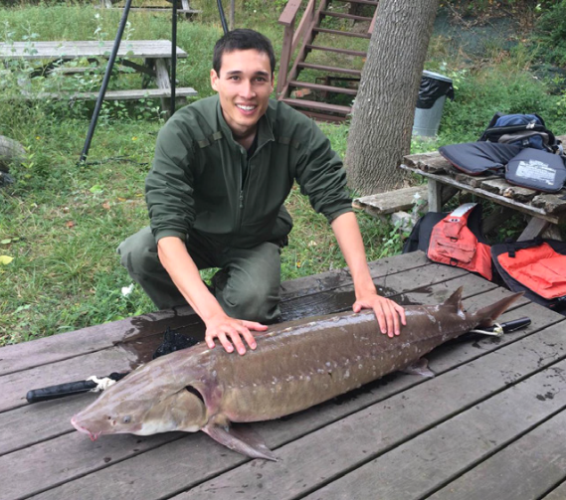
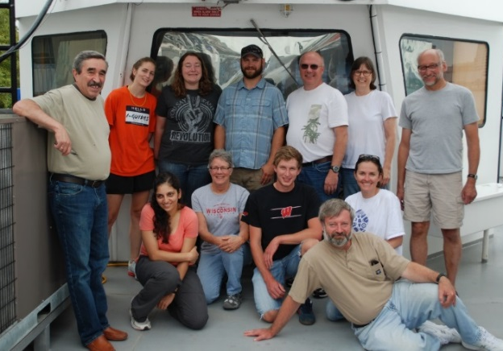
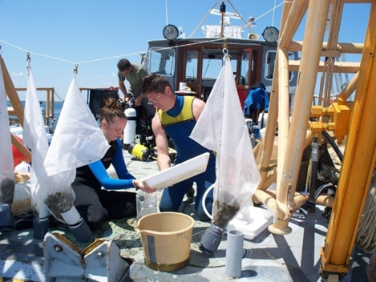
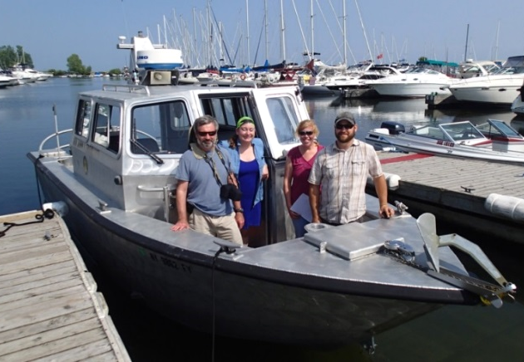
Geography of Our Research:
US from the Rio Grande to the Niagara River
Canada
Europe
South America
Sturgeon research in the Niagara River
Survey of zebra mussels in Canada
Monitoring of Great Lakes
Processing mussel samples, Lake Ontario

Slide 6

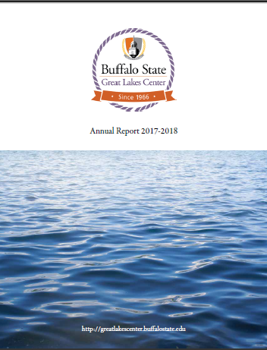
About GLC

Slide 7
Research in Ecology USSR vs. USA
(major tendency, exceptions frequent)
 | USSR | USA
Major institutions | Academic Institutes | Universities
Research units | Laboratories | Professor
Who get funding | Institute/Lab | Project (PI, PIs)
Duration | Long | Short (1-5 years)
Research directions | Stable, long-term, not much driven by short-term funding | Flexible, short-term, largely driven by funding
Major time investment | Research, publications, presentations | Chasing money, project managements, research, publications, teaching
Outcomes for scientist | Long-term concentration on few areas allows to became the expert in the field (e.g. taxonomy) | Switch among projects allows accomplishments in many areas, but prevent to became the expert in the field
Work Intensity | Intense but allows long-term vocations and other activities | Very intense, no long vacations, not much of other activities
Consequences | More long-term data accumulated | New ideas more quickly adopted. Less long-term data. (Open and easy access of publicly funded data)

Slide 8
Invasive Species

Slide 9

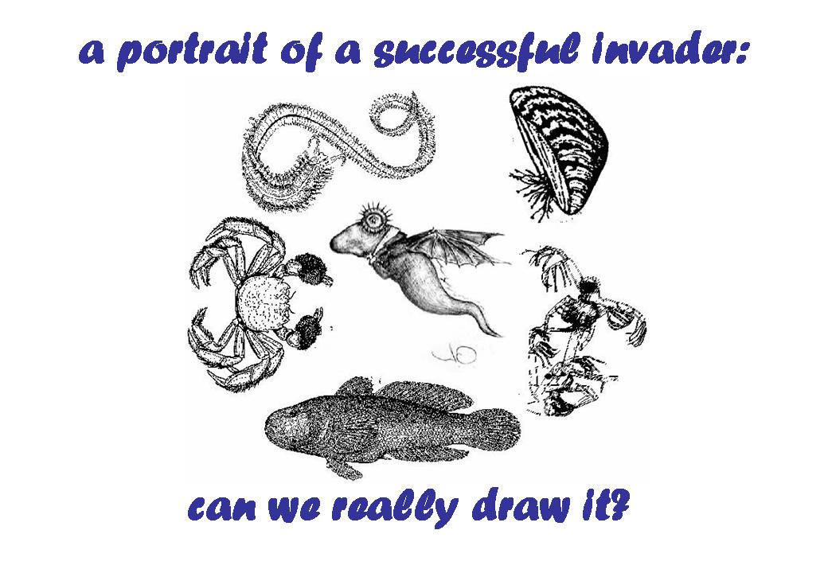
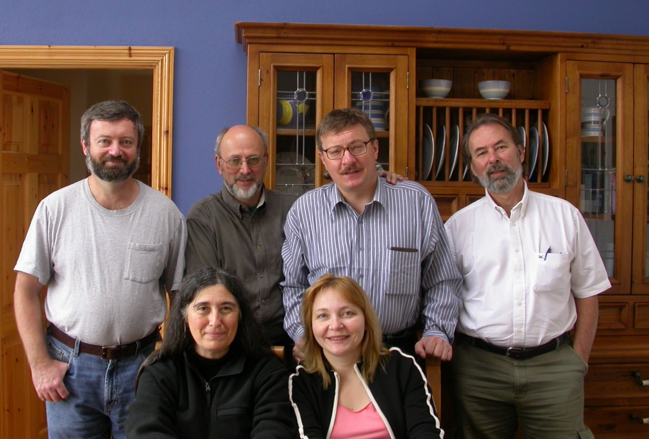
Portrait of a Successful Invader
6 scientists spent 10 days in Ireland trying to draw a portrait of an invader
95 freshwater, brackish, and marine invertebrates
55 life history and environmental parameters
?

Slide 10
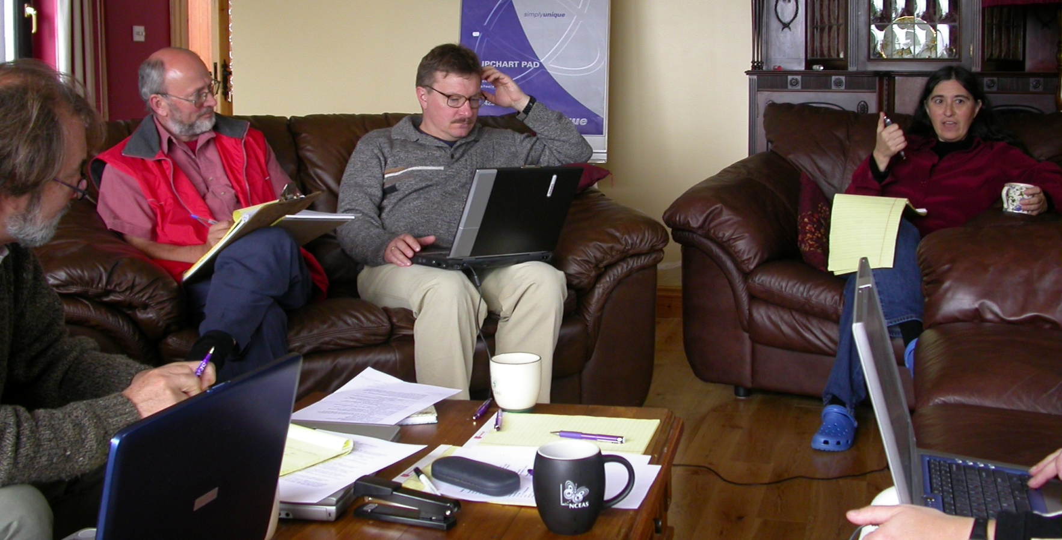
Portrait of a Successful Invader. Challenges:
Almost impossible to reach agreement
Not enough data, especially for native species to compare
How to quantify Invasiveness?

Slide 11
Results
Freshwater invaders are overrepresented by molluscs and crustaceans, while native - by insects
All invaders are tolerant of at least moderate pollution
Suspension feeders were more abundant, and predators less abundant among invaders than among native invertebrates
The spread of exotic species shifts communities toward greater tolerance of pollution and increases the numbers of suspension feeders enhancing benthic pelagic coupling

Slide 12
The ultimate invasive species is
man…
He takes, deliberately or accidentally, other species with him
number in the tens of thousands:
house plants,
pets, pests,
garden ornamentals,
vegetables,
insects
birds
etc.

Slide 13

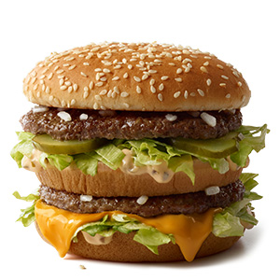
The Most Iconic American Brand
Wheat originated in Southwest Asia
Onions originated in central Asia
Cucumber originated in India
Beef originated in the Old World
Lettuce was first cultivated in Egypt

Slide 14
Introduced Species
Beneficial - corn, wheat, rice, cattle, etc. provide > 98% of the US food ($800 billion/year)
most pets, ornamental plants
However
About 15% of introduced species have become invaders, causing ecological and economic problems

Slide 15
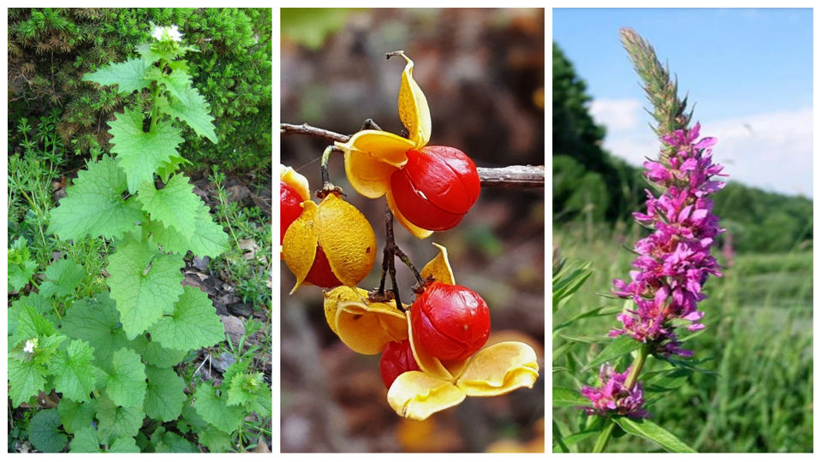
The Scale of the Problem
The second largest threat to natural ecosystems worldwide
The first largest threat is habitat destruction
Since US was first colonized, > 50,000 foreign plant and animal species have established

Slide 16
Invasive Species Can Cause Problems for:
Estimated Damage:
$ 138 billion/y environmental damage
$ 125 billion/y economic losses
human health
industry
agriculture
forestry
waterways

Slide 17
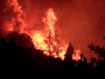
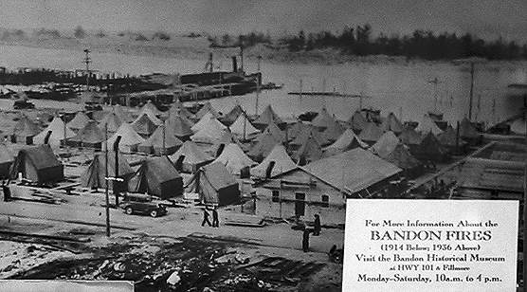
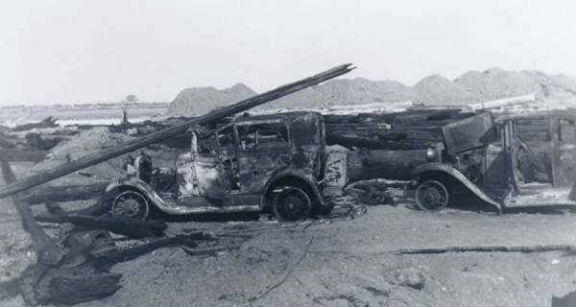
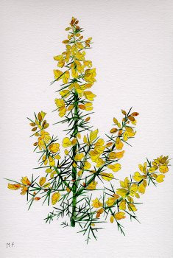
Effect
1936: the town of Bandon, Oregon was destroyed
11 citizens were killed by a fire
gorse - a highly flammable plant introduced 70 years earlier from Europe

Slide 18
TERMINOLOGY is a Mess
Alien
Exotic
Invaders
Foreign
Immigrant
Non-indigenous
Non-native
Feral
Terms are not standardized.
Different authors and sources may use these terms differently–watch!
Be certain you know what a given source means or that the reader or listener knows what you mean.
Not all exotic species are invasive and not all invasive species are exotic

Slide 19
Definitions
Imported - species found in collections or accidentally brought into the country
Introduced - found outside control or captivity as a potential self-sustaining population
Established - that the species established a stable population in a new habitat
Pest - a species that cause significant economic and/or ecological problem (invasive species)
“The tens rule”
1 in 10 imported species could be found in the wild (introduced)
1 of these 10 species could establish a stable population in a new habitat
1 of these 10 species could become a pest
1000 100 10 1
imported introduced established pest

Slide 20
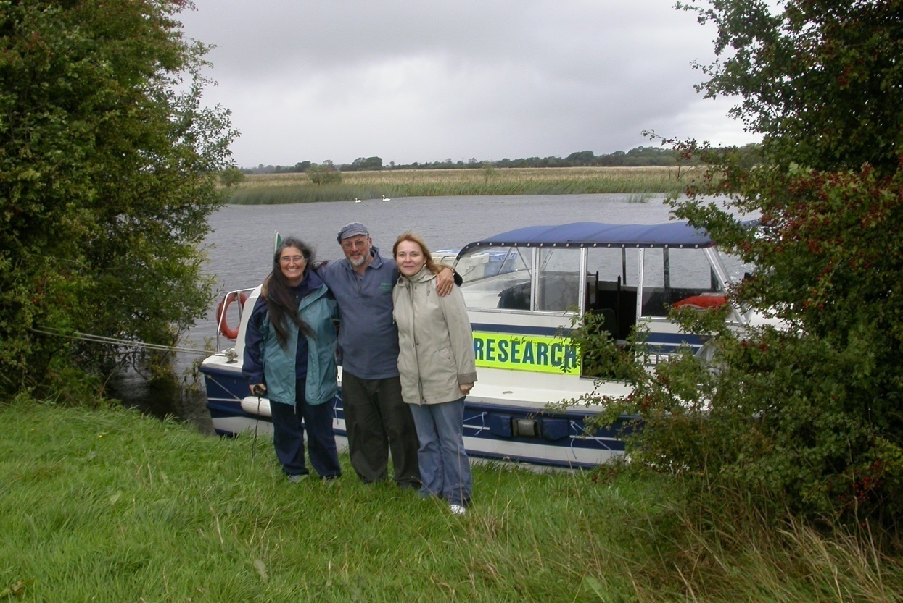
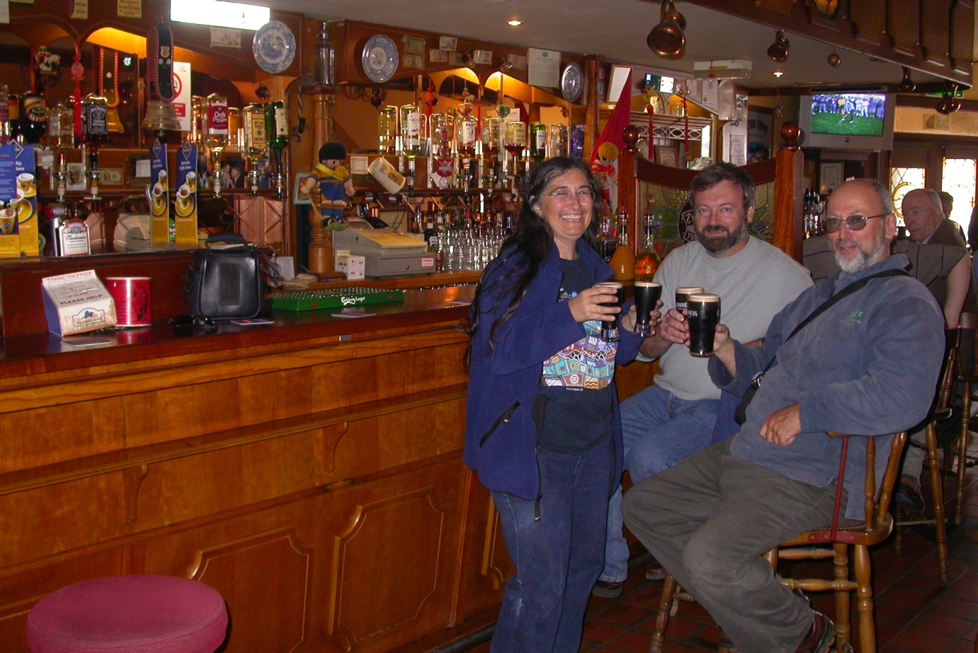
Irish Ballad
Once upon-a-time sitting in Irish pub we start talking about the spread of exotic species
and taking notes on a napkin

Slide 21
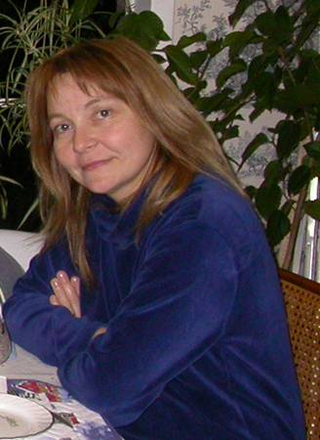

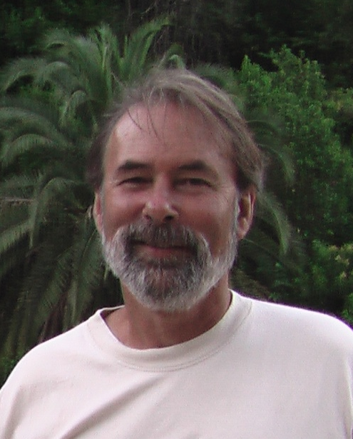

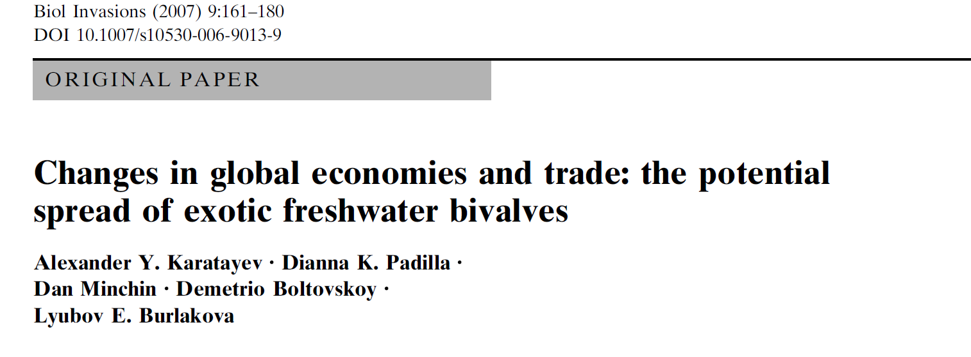
Dianna Padilla Department of Ecology and Evolution, Stony Brook University, USA
Demetrio Boltovskoy Universidad de Buenos Aires, Argentina
Lyuba Burlakova
Great Lakes Center, Buffalo State College Buffalo, NY, USA
Dan Minchin
Marine Organism Investigations, Ireland
In 3 years we published a paper

Slide 22
Historically, Europe and America did not have powerful benthic suspension feeders that:
attain high densities, have high growth, and rapid recruitment
provide a direct link between benthic and pelagic parts of ecosystem
alter substrate type and act as ecosystem engineers
However such species did exist in Asia, Africa, and small regions in Europe,
including the most iconic
Dreissena polymorpha (Pallas),
the zebra mussels.

Slide 23
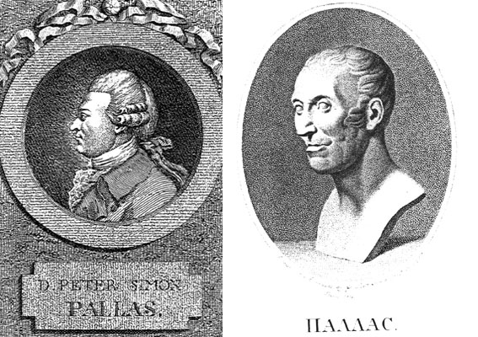
Dreissena polymorpha
were first found in 1769
Ural River close to the Caspian Sea
by German scientist Peter Pallas

Slide 24

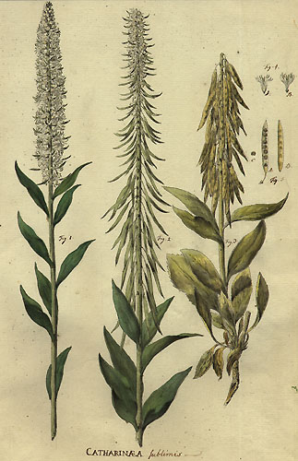
Journey Through Various Provinces of the Russian Empire (1771-6).

Slide 25
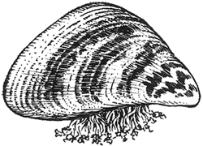
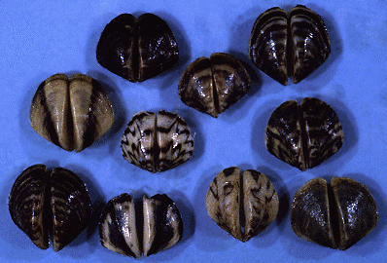
Pallas: Mytilus polymorphus
as they looked like marine mussels Mytilus
shell color
varied widely

Slide 26
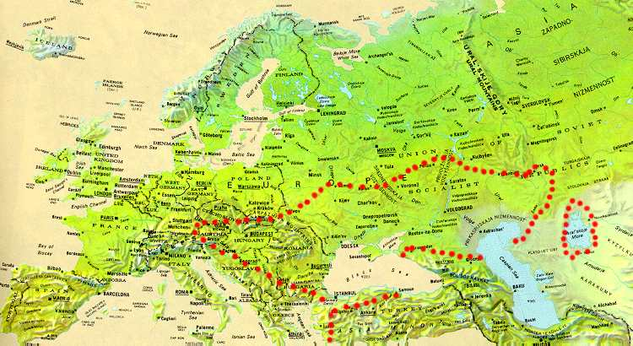
Zebra mussels were originally found in the fresh and brackish waters of the Caspian and Black Sea drainage basins including large tributary rivers

Slide 27
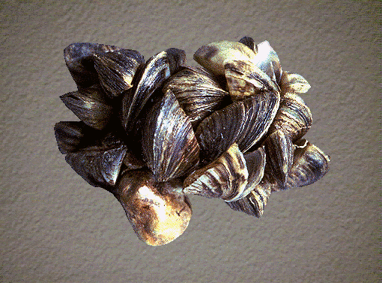
Dreissena polymorpha and D. rostriformis bugensis have properties common for marine mussels, but in freshwaters represent
novel ecological type

Slide 28
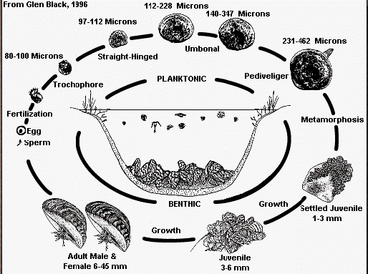
Planktonic larvae

Slide 29
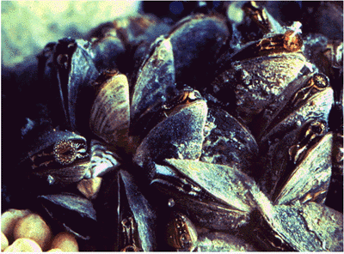
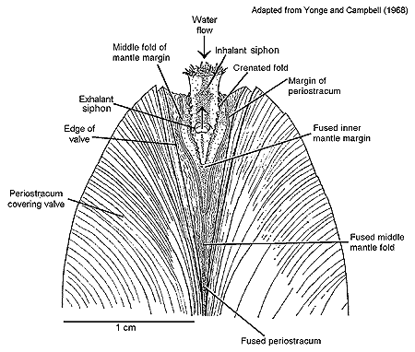
Filter Feeders

Slide 30
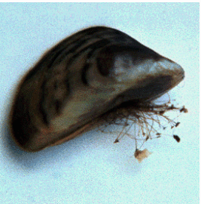
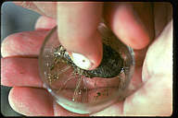
Byssus
only Dreissena can attach to hard substrates in freshwater
byssal threads
secreted
by the foot
2.5 cm mussel
may have up to
600 threads

Slide 31
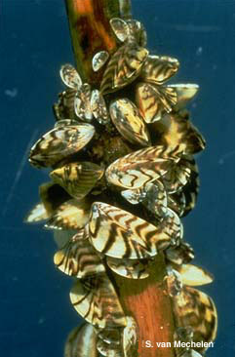
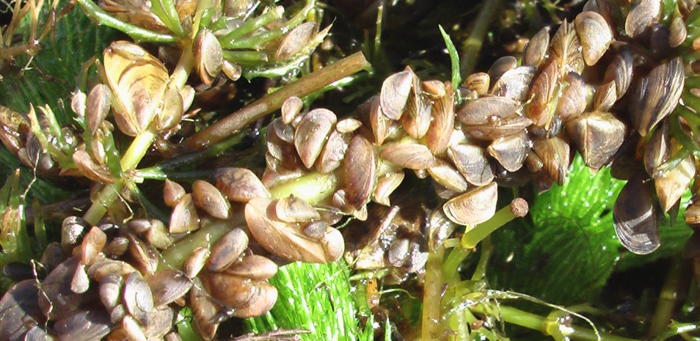
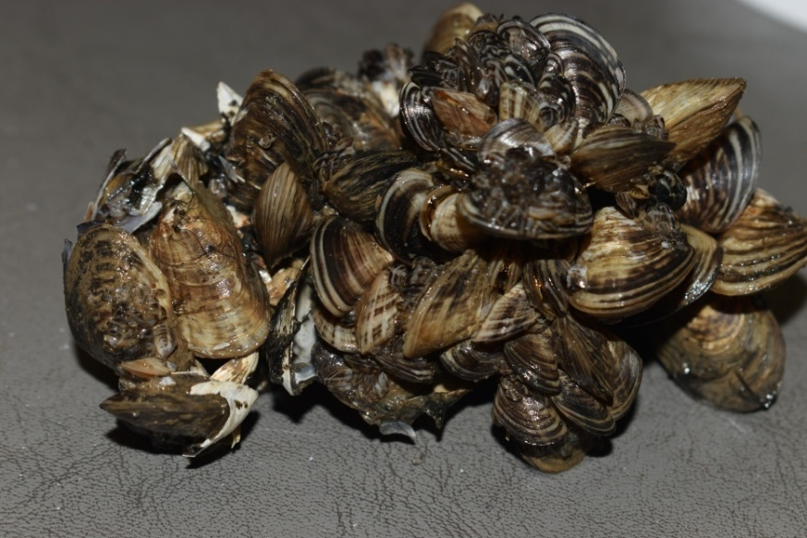
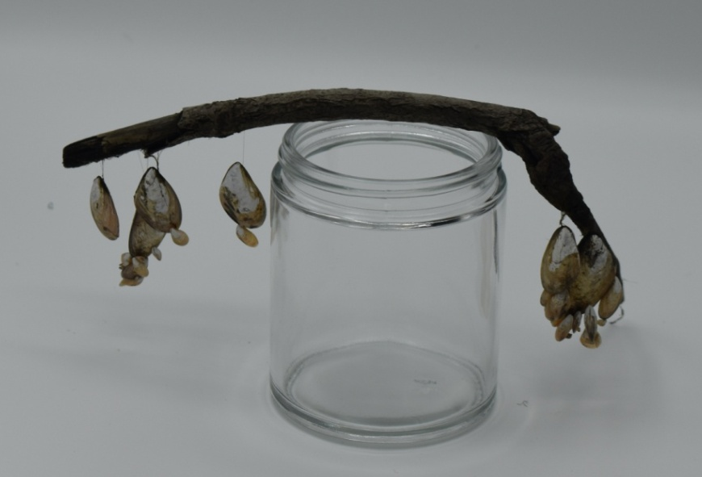
Dreissena polymorpha (Zebra mussel)
Native to the Caspian and Black Sea basins
Dreissena r. bugensis (Quagga mussel)
Native to the Dnieper-Bug Liman

Slide 32
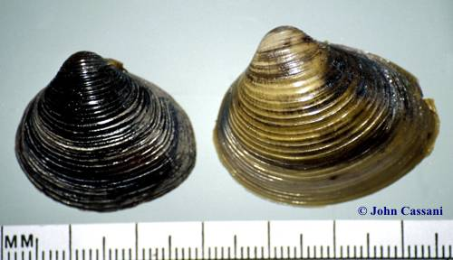
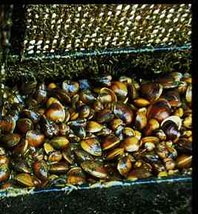
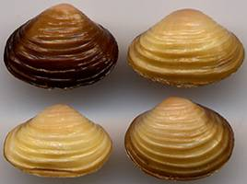

Corbicula fluminea (Asian clam)
Native to Asia, Africa, and Australia
Corbicula fluminalis
Native to Central Asia

Slide 33

Limnoperna fortunei
(Golden mussel)
Native to southern Asia
1965 - colonized Hong Kong
1980s - found in Japan
1990s - spread to South America

Slide 34
We hypothesized that:
The spread of exotic species has not been continuous, but rather punctuated by periods of rapid long-distance spread (jump), during which species greatly expanded their geographic ranges.
Each jump has been associated with human activity, such as:
construction of canals
building of reservoirs
political boundary changes
human migrations
changes in the volume of international trade
industrial practices and environmental laws
The rate of spread of exotic species depends on the spatial scale and may be accelerated or slowed by various human activities
We used the spread of exotic freshwater bivalves as an example to test these hypothesis

Slide 35


First jump of exotic bivalves has been associated with the construction of inter-basin shipping canals for trade
Inter-basin canals were built in Russia to connect the large, navigable rivers, and the Black and Baltic Seas
Dnieper-Bug Canal

Slide 36

Construction of Shipping Canals
In 1824 D. polymorpha was found in London
“”The appearance of D. polymorpha in Britain corresponds with a period of great increase in international trade” (Kerney & Morton 1970)
Netherlands (1826),
Germany (1830),
Holland (1833),
Belgium (1833),
France (1838),
Denmark (1840)
1922
1803
1993
1840
1826
Only countries with an intense trade-related transport were colonized (Ireland was colonized in 1993)
1830
1838
1865

Slide 37

Cumulative Spread of Zebra Mussel
Initial exponential spread in the 19th century
No spread for about 80 years
Secondary exponential spread (North America, and expansion in Europe: alpine lakes, Ireland, Italy and Spain)
(From Karatayev et al. 2011)

Slide 38


Cumulative Spread of Quagga Mussel
Quagga mussel remained restricted to their native range until the middle of the 20th century
in 1940s spread throughout Dnieper River colonizing newly constructed reservoirs
within a few decades, its rate of spread increased exponentially (twice higher than that of D. polymorpha)
(From Karatayev et al. 2011)

Slide 39
Why the mechanisms and vectors of spread successfully used by zebra mussel did not work for quagga mussel?
In the 19th century Dreissena was mainly spreading through canals and rivers in Europe attached to the vessel and rafts, therefore the strength of the attachment was critically important for the successful invasion
Habitats initially colonized with zebra mussels were mostly shallow areas of rivers and canals. These habitats are excellent environment for D. polymorpha, but D. r. bugensis prefers quiet areas of deep waterbodies

Slide 40

What Happened after 1940s?
1. Newly constructed reservoirs became the “stepping stones” for the invasion
2. New vectors of spread became available:
ballast water,
canals became larger than in the 19th century,
increased rate of commercial and recreational ship traffic ,
overland movement of pleasure boats.

Slide 41

Construction of Reservoirs
Dams facilitate dispersal of invasive species by:
creation of more favorable environmental conditions
enhancement of recreational activities associated with river damming projects

Slide 42



Construction of Reservoirs
Limnoperna fortunei was introduced Río Tercero Reservoir on boats trailered overland from the Paraná or Uruguay rivers

Slide 43

Political Borders
r² = 0.87
Lakes=2.1 Year-4043
r² = 0.47
Lakes=0.04 Year-74
From 1922 to 1939, Belarus was divided between the USSR and Poland, and the range expansion of D. polymorpha was very slow
After the Second World War, the rate of spread increased dramatically

Slide 44


Socialism vs. Capitalism
Vectors for D. polymorpha spread:
Socialism: commercial fisheries (subsidized by government)
Capitalism: recreational boats

Slide 45

Collapse of the USSR:
Commercial fishing declined
Recreational tourism became an important vector for Dreissena spread
Dreissena colonized many isolated lakes that were used for recreation but not for commercial fishery
Increase in trade and exchange of exotic species between Eastern and Western Europe

Slide 46

Human Migrations
Deliberate introduction of edible bivalves as a food source, or accidental introduction of inedible organisms, together with live seafood.
Corbicula fluminea was brought to North America by Asian immigrants?
Shipping of C. fluminea as a food from China was the route for the introduction of L. fortunei to Japan?

Slide 47

Increased International Trade in 20th Century
D. polymorpha and D. bugensis colonized North America
South America was colonized by C. fluminea and L. fortunei
Europe was invaded by C. fluminea and C. fluminalis.

Slide 48
Industrial Practices and Environmental Laws
Local industrial practices can greatly alter the suitability of waterbodies for species, as well as controls on pollution
Zebra mussels initially colonized waters across Europe; however, as rivers became polluted, Dreissena disappeared
Recent environmental laws across Europe have required cleanup and reduced the input of pollutants
As a result of the recent improvements, zebra mussels have reinvaded these rivers

Slide 49





Industrial Practices and Environmental Laws
The improvement in water quality in GL has been correlated with a dramatic increase in the successful invasions, including dreissenids, which are now important ecological factors driving dramatic changes in these systems, preventing restoration of the native communities (Mills et al. 2003)
Bythotrephes
Dreissena polymorpha
1960s
1970s
1980s
1990s
2000s
Great Lakes Water
Quality Agreement
Dreissena bugensis
Cercopagis

Slide 50
Industrial Practices and Environmental Laws
Recent political changes in China have resulted in rapid industrialization and dramatically increased international trade
Water pollution has dramatically increased, possibly closing the door to Chinese ports as a source of Limnoperna for invasion to other areas as compared to early 1980s when this species invaded South America
When the water quality in Chinese ports will improve, China may become a major source of invasion

Slide 51
Conceptual Model of the Spread of Exotic Bivalves
(initially drawn on a napkin in Irish pub)

Slide 52


Exotic Bivalves as Ecosystem Engineers
“Directly or indirectly control the availability of resources to other organisms by causing physical state changes in biotic or abiotic materials”
Jones et al. 1994, 1997
Examples include:
Kelp forest
Marine mussel beds

Slide 53


Exotic Bivalves Have all of the Properties of Ecosystem Engineers
Just by their presence, they change the characteristics of environments
Other changes are caused by feeding and filtering
These changes can be system-wide, or have only local impacts

Slide 54
Filtering capacity of different communities in Lake Lukomskoe (time required for filtering the volume of the lake)
System-wide Effect of Dreissena
COMMUNITY | BEFORE Dreissena Invasion | AFTER Dreissena Invasion
Zooplankton | 5 days | 17 days
Zoobenthos | 15 years | 17 days

Slide 55

After Dreissena Invasion
INCREASED | DECREASED
Transparency | Seston
Macrophytes | Organic matter
Zoobenthos | Phytoplankton
Fish productivity | Zooplankton

Slide 56

DREISSENA IMPACT ON THE NAROCHANSKIE LAKES
Colonized by Dreissena in 1980s
Best studied lakes in FSU
Monthly data on chemistry and aquatic communities available since 1946

Slide 57
Dreissena Impact on Narochanskie Lakes
Water transparency increased 2 times
Seston and chlorophyll concentration decreased 3 to 7 times
Phytoplankton primary production, respiration and biomass decreased
Zooplankton density and biomass decreased
Macrophytes coverage increased
Highly eutrophic Lake Batorino ⇒ eutrophic
Eutrophic Lake Myastro ⇒ slightly eutrophic
Slightly eutrophic Lake Naroch ⇒ mesotrophic
Similar results were later obtained on many other waterbodies colonized by Dreissena in Europe and North America

Slide 58
Ecosystem Impact of Dreissena on invaded waterbody
(Zebra mussel as ecosystem engineers Karatayev et al. 2002)

Slide 59
Questions?

